Slide 1
Hornbeam, Plane and Rowan
Year 3 & 4

Slide 2
Staff
Staffing in Year 3/4 is as follows –
Plane
Miss Gladstone (Class Teacher and Phase Leader)
Mrs Van Wyk (Associate Teacher)
Rowan
Miss Norton (Class Teacher)
Hornbeam
Mrs Mulholland (Class Teacher)
Support staff – Kay, Nina, Debby, Jill and Loretta

Slide 3
Attendance and Punctuality
All children should arrive in school between 8.45 and 8.55 am. Drop at the gate. Children will come directly to class for early morning work. Both the gate and playground will be supervised during transition.
If your child is unwell please notify the office as soon as possible – please keep children off school for 48 hours after an upset stomach.
In line with government policy, holidays may no longer be taken during term time.
Lateness is monitored; your child should sign in at the office if they arrive after 8.55am.
Certificates and prizes are awarded for classes and individuals with excellent attendance.
Please encourage your children to attend even if feeling a little under the weather.

Slide 4
Collection Arrangements
All children in Years 3 and 4 will be collected from the playground outside Plane and Hornbeam classes.
Please do not gather by the shelter but move along the whole space to avoid congesting this area.
For safeguarding reasons, parents should wait behind the playground markings.
Please note that if you need to let us know of a change in collection arrangements, this should be reported to the office in the first instance. Children booked into After School Club, must be collected from there and not the playground.

Slide 5
Curriculum
You will receive termly curriculum newsletters. Please look at these to enable you to support your child with their learning. This will also give you advance notice of important dates such as assemblies and trips.
Ways in which you can do this include choosing relevant books in the library, researching online, discussing at home and local visits.

Slide 6
Educational Visits & Visitors
Samba Day (Autumn term)
Romans Trip to Cressing Temple Barns (Spring term)
Rye Mead Nature Reserve (Summer Term)
For our trips to be successful we do rely on parent volunteers. This will not be on a first come, first served basis but will be organised in a fair way.

Slide 7
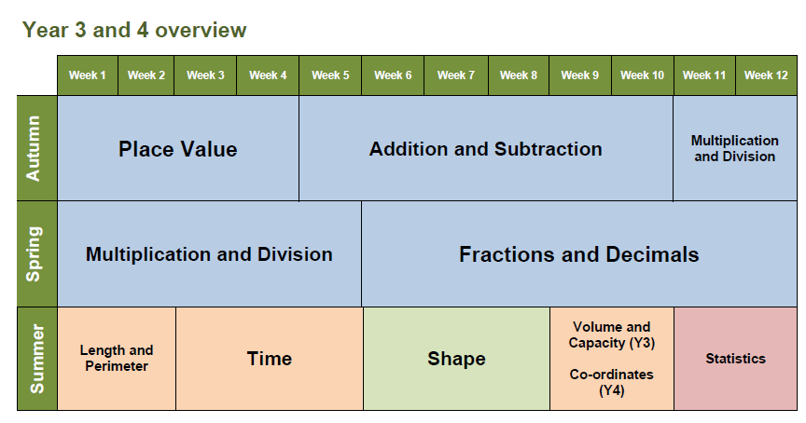
Maths
We are following the White Rose Maths Hub scheme of work. The yearly overview is shown below.

Slide 8
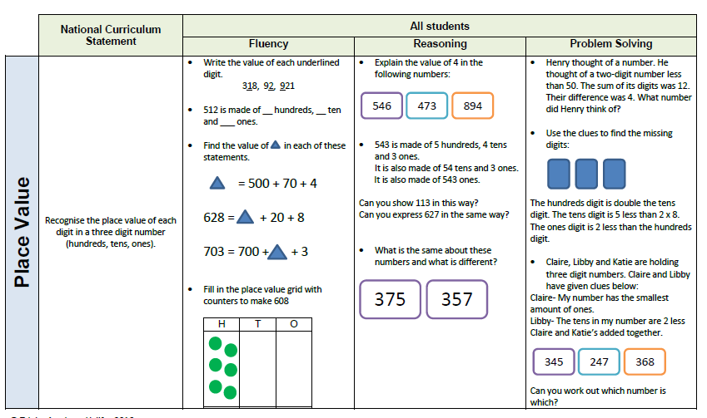
Maths
Children no longer choose their challenges but all work through the phases of fluency, reasoning and problem solving. The idea is that all children can access this with the use of manipulatives and children are challenged more deeply through problem solving.
This scheme follows the concept of maths mastery where the emphasis is on deeper understanding.

Slide 9
Workshops
Maths and English workshops will be advertised when they take place. These will be based in Plane Class and you will be notified by Parentmail of forthcoming sessions.
Sessions will be an opportunity to support families with areas of the curriculum that we feel would be of benefit. There will not necessarily be any hand-outs available.

Slide 10
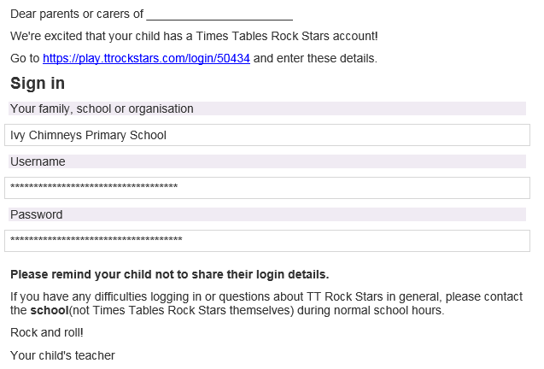
Homework
The best way to support your child is by using Times Tables Rock Stars.

Slide 11
Homework
At the end of Year 4, children will sit a Government test on their times table fluency. It is imperative that all children can recall all multiplication facts to 12 x 12 by the end of Year 4. Data collected will be published nationally.
Each Friday, children will be tested on Times Tables Olympics which involves a 3 minute speed test.
Finalist – 2s, 5s, 10s
Bronze – 2s, 3s, 4s, 5s, 10s
Silver – 6s, 11s
Gold – 7s, 8s, 9s, 12s
European Champion – All (60 mixed questions)
Olympic Champion – All (100 mixed questions)
By the end of Year 3, children should be at the level of Silver and as previously stated, Year 4 children must know all multiplication and division facts to times 12 (Gold or above).

Slide 12
Homework
Regular reading with an adult at home is essential. Diaries should be completed and signed by the adult. If choosing books from home, we encourage you to support your child in carefully selecting quality texts which will improve their vocabulary and inference skills. (Please see the Fab 50 list of recommended reads.)
Spellings will be given weekly to learn at home. Please use a range of strategies to encourage your child. These will be tested the following Friday.
Times Tables, as mentioned in the previous slide, should be practised regularly for weekly testing. Times Table Rock Stars is recommended.
A Mathletics homework will be set weekly. Completion of online homework is expected. If there is a problem with access, please let us know.
Brain Builder will continue to be a bi-weekly aspect of homework. This should be child-led and is not intended to be labour intensive for parents. Class incentives will be available for completing Brain Builder.
Your child may also occasionally bring work home to finish.
Ordinarily, homework remains unchanged from week to week, therefore, we will not communicate this by Dojo unless there is a change.

Slide 13
Logins
You child will have the following logins:
Mathletics
Times Table Rock Stars
These have been provided to the children already.
We politely ask that you keep all logins in a safe place / written down centrally as re-issuing these is incredibly time consuming.

Slide 14
Volunteers
We welcome the help of parents with reading and ask that you complete the relevant form on the website if you wish to be considered for this.
All volunteers will be DBS checked.

Slide 15
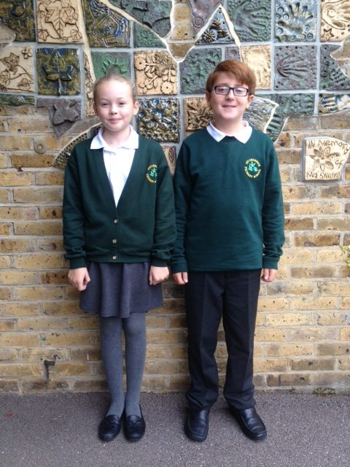
School Uniform
All children are expected to wear the appropriate school uniform at all times.
Grey skirt, pinafore, shorts or trousers with white polo top
Gingham dress (“summer”)
School jumper or cardigan
Plain black shoes – not trainers, no heels, no boots
No make-up or nail varnish should be worn in school.
No jewellery should be worn, except plain stud earrings and named watches.
No earrings are to be worn on PE days. If you are considering having your child’s ears pierced, we would recommend this takes place during the summer break.
PLEASE ENSURE THAT EVERYTHING THAT YOUR CHILD WEARS IS CLEARLY LABELLED. UNMARKED LOST PROPERTY WILL BE DISPOSED OF ON A REGULAR BASIS.

Slide 16
PE Kit
Your child should have the appropriate kit in school every day, in a named drawstring bag. Each item of clothing should also be individually named.
Trainers *
A change of socks
White school t-shirt
Green shorts
Children may also bring tracksuits to wear for outdoor activities in PE.
*Plimsolls are optional for indoor PE only.
Watches and stud earrings must be removed for PE, games and swimming. Please note that the school cannot be held responsible for the security of such items. We recommend that earrings are removed at home on PE days. If your child is unable to remove their earrings, they will be unable to take part in PE (this includes recently pierced ears). This is the Essex policy for all schools and is required for insurance purposes.
If a child does not have their full and correct PE kit on a PE day, they will receive a letter to the parent. If this happens three times, you will be contacted by a member of SLT.

Slide 17
Daily Mile
In addition to PE, where possible, we will be endeavouring to give children time to complete a “daily mile”, using our wonderful new daily mile track, provided by FOICS.
It is recommended that your child has a pair of trainers which can be left in school for this purpose. Like all other clothing, please ensure that each trainer is clearly named inside the shoe. Sharpie pens or other permanent markers are great for this.

Slide 18
Water and Snacks
Children should bring in a named water bottle to keep in the classroom for drinks during lesson time and taken home every day for washing and refilling.
Only healthy snacks, namely fruit & vegetables, may be brought in to be eaten at break times – products containing nuts are not allowed.
Birthday treats are no longer permitted in line with our healthy schools policy.

Slide 19
E-Safety
In school, our internet is restricted to ensure safety and suitable content. We educate and encourage children to stay safe whilst using social media. We remind them that Facebook, Twitter, Instagram and video games etc all have age restrictions and that these age restrictions should be followed both in school and at home.
Please support us with this important safeguarding issue by adhering to age restrictions on games and websites.

Slide 20
Communication
Please note that if you need to report an absence, appointment or change in pick up arrangements, this should be reported to the office in the first instance. Children booked into After School Club, must be collected from there and not the playground.
Parents can stay in touch with news, announcements, assemblies and achievements via the school website, Twitter and Class Dojo accounts.
Please discuss sensitive issues face-to-face and be aware that electronic communication is unlikely to be responded to outside of working hours. It is unlikely that messages will be seen during teaching hours.

Slide 21
Cloak room
As you will have read on our homework letter sent before the summer holidays, due to the constraints of space in cloak room areas, we ask you to consider the size of children’s bags. Large rucksacks are extremely hard to accommodate and not needed.
This will become even more problematic during colder months when children bring heavy coats to school.
Children are provided with stationery. Pencil cases and other stationery are not necessary.

Slide 22
Independence
A continued school focus this year is to develop the children’s independence.
Children in KS2 are expected to change their own reading books, usually during registration or guided reading time. They will not be reminded to do so.
We would ask for your support in encouraging your child to be responsible for packing and carrying their own bag, ensuring that they have everything they need –
Reading book and diary, packed lunch (if necessary), water bottle and PE kit.

Slide 23
Finally…
We look forward to working with you and your child this year. We hope that it is happy and successful.
Good night.

