Slide 1
EYFS Parent workshop: the end of reception and getting ready for Year 1.

Slide 2
The purpose of this workshop…
Requests from parents – feedback from last year’s parent questionnaires
Pre-teach session
End of year expectations for reception children
How to best support your child

Slide 3
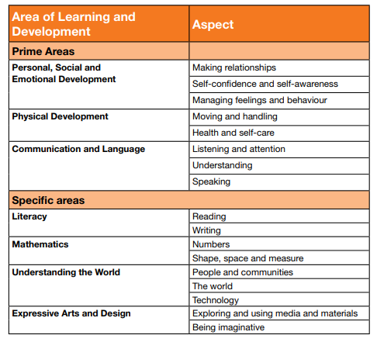
The end of reception: the ELGs
The Early Years (reception) curriculum is broken into 17 different areas.
Each of these areas has an end of year statement, or an Early Learning Goal (ELG).
These goals are the 17 different targets that a typical reception child is expected to meet at the end of the year.
We work towards these constantly throughout the year and assess against them by looking at the children’s work, carrying out observations of their learning and documenting it on Tapestry, our own teacher knowledge of your child and from your experiences at home that you tell us about either via Tapestry or other mediums.

Slide 4
Today we will be looking in depth at…
Maths
Literacy
Spellings

Slide 5
Number ELG
Children should be able to…
‘count reliably with numbers from 1 to 20, place them in order and say which number is one more or one less than a given number. Using quantities and objects, they add and subtract two single-digit numbers and count on or back to find the answer. They solve problems, including doubling, halving and sharing’.
If children are exceeding…
‘children estimate a number of objects and check quantities by counting up to 20. They solve practical problems that involve combining groups of 2, 5 or 10, or sharing into equal groups’.

Slide 6
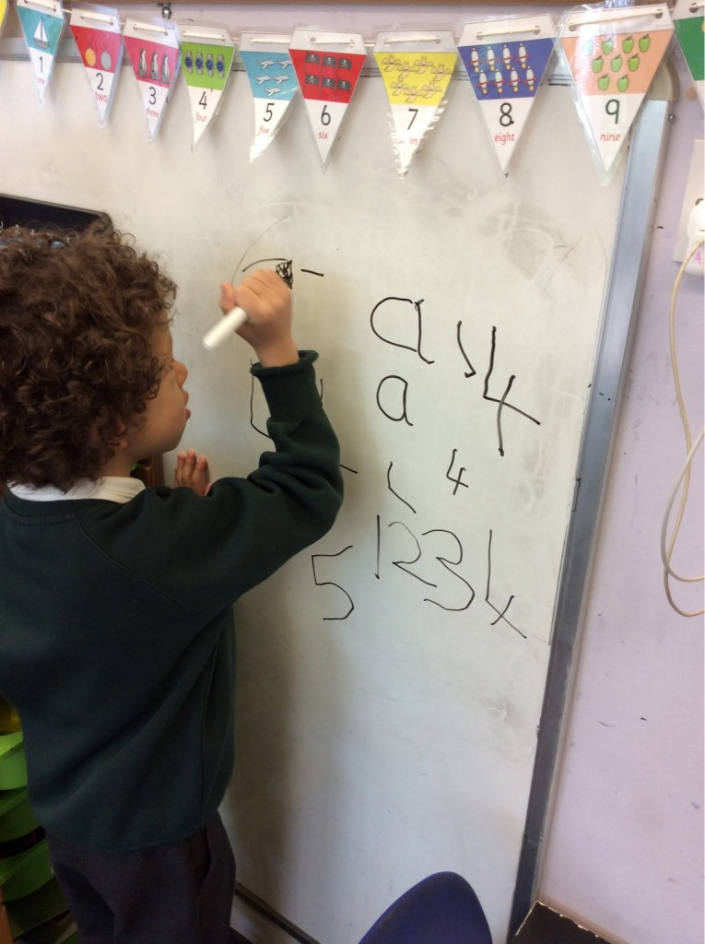
Ordering numbers count reliably with numbers from 1 to 20, place them in order and say which number is one more or one less than a given number.
Practise with your child…
Counting forwards or backwards from 0 to 20 but start at different numbers!
Children quickly learn counting by rote like a song – it’s hard to start from a different number each time.
You can use a number line or ruler to help support this if your child is struggling.
This can be done anywhere!
If you spot a number on a car registration plate, can you count forwards or backwards from that number?
Extend them: try this up to 100
Counting in 2s, 5s or 10 (practically, not just by rote)
Estimating how many objects they can see

Slide 7
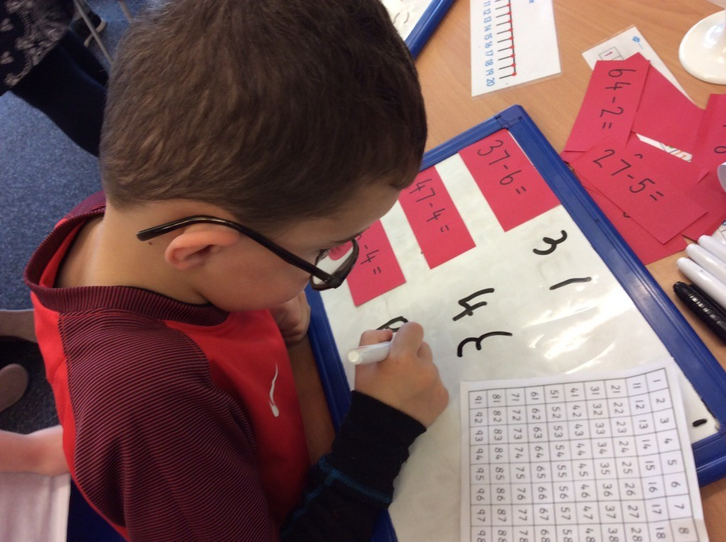
Adding and taking away Using quantities and objects, they add and subtract two single-digit numbers and count on or back to find the answer..
This will be with numbers up to 20, e.g. 17+7=
We haven’t tackled adding two 2 digit numbers together yet, e.g. 17 + 12 =
Put the big number in your head (17)
Put the smaller number on your fingers (7)
Count on from the big number, shutting down your fingers as you go
When you run out of fingers, that’s the answer!

Slide 8
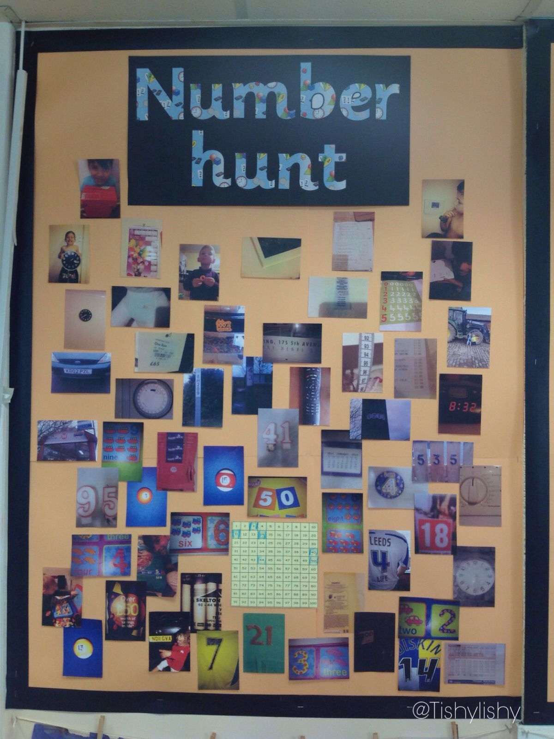
Other ways to support in Number…
Counting in twos, fives and tens – do this practically rather than by rote (socks, pasta, money)
Doubling, halving and sharing – practically at home
Use next steps on Tapestry observations for further practice – you can comment and let us know how you got on.
Pointing out numbers wherever you are
Encouraging your child to look at prices in shops
Add money amounts together
Talk about numbers on car number plates
Make sure children are forming numbers the correct way around

Slide 9
Space, Shape and Measure ELG
Children should be able to…
‘use everyday language to talk about size, weight, capacity, position, distance, time and money to compare quantities and objects and to solve problems. They recognise, create and describe patterns. They explore characteristics of everyday objects and shapes and use mathematical language to describe them’.
If children are exceeding…
‘estimate, measure, weigh and compare and order objects and talk about properties, position and time’.

Slide 10
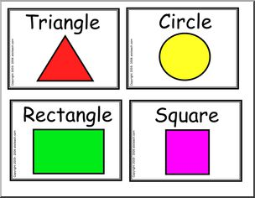
Shapes
Children should be able to recognise a square, circle, triangle and rectangle AND talk about how many sides and corners they have
Children should be able to recognise a cube, cuboid, sphere, cone, pyramid and cylinder and talk about how many faces they have and describe them – are they pointy or flat?

Slide 11
How to support: Space, Shape and Measure
Talk about different 2D shapes you can see in the home/ town/ supermarket
Talk about and hunt for different 3D shapes (your food cupboards are the best place to look!)
Talk about weighing when cooking
Encourage your child to find out how long things are by using different units to measure them – e.g. buttons, pasta shapes, teddies (this is how we teach measurement in the EYFS – rulers and measuring tapes are more of an exceeding extension and they need to be confident with different units first)
Talk about how much money they have in their piggy banks and how much things cost and the concept of getting change when paying for items.
Point out different patterns you see in the environment
Talk about what the time is – o’clock then half past then quarter past/ to.
Encourage your child to talk in positional language – not just to describe an object as being ‘over there’.

Slide 12
Reading: how to support
Children need to understand what they’ve read – after each sentence, cover up the picture and ask your child what’s happened.
Practise the word pot blends before you read the book – sometimes this is at the front of the book to help you
If it’s a tricky word (one of the words in their pot), correct your child if they try to sound it out.
Challenging
If there’s speech or an ! or ? – encourage your child to read with expression (this may need to be modelled)
Encourage your child to talk more in depth about the story and the characters and what they thought of the story
Encourage your child to write a book review.
Remember: it doesn’t need to be the phonic books, you can also encourage your child to read words in picture books and books from the library.

Slide 13
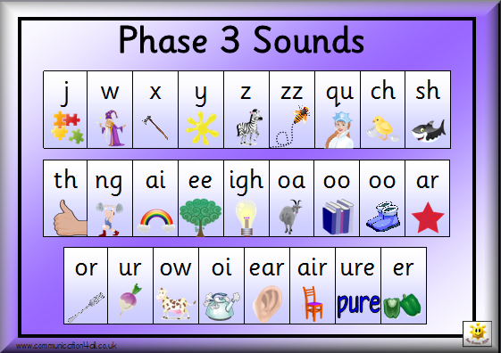
Extending the word pot
Use the tiles to build words
Choose a digraph/ trigraph (e.g. ‘oo’ or ‘igh’) and ask your child to think of different words with that sound in.
It’s not just about recognising the tricky words. Your child could…
Write them from memory
Pick one and write a sentence with it in – bonus points if they can write a sentence with more than one in!
Encourage your child to look through their word pot independently and make up their own games.

Slide 14
How to support writing at home…
Letter formation is very important! You can correct your child appropriately if a letter is back to front – this can mark them down when their writing is assessed and moderated.
Tricky words they know must be spelt correctly – you can correct them if they don’t spell them correctly at home (we have them out on display when the children are writing so that they can check them as they write)
Finger spaces, full stops and capital letters at the beginning of a sentence
Do not tell them how to write a word.
Model writing in the home
Writing for a purpose
Shopping lists/ sign if they don’t want a model they’ve made to broken/ birthday cards/ letters to friends or family/ a note to a parent who’s coming home later from work/ diaries/ instructions on how to make something that they’ve made – crafty or construction/ have lots of themed notebooks and fun stationery – the list is endless!

Slide 15
Extending their writing
Stretch sentences using and, because, next, so, but
Use exclamation or question marks
Add extra detail and adjectives ‘the green slimy frog jumped’
Rewrite and adapt stories they know – e.g. the three little wolves
Use lots of tricky words!
Use speech marks

Slide 16
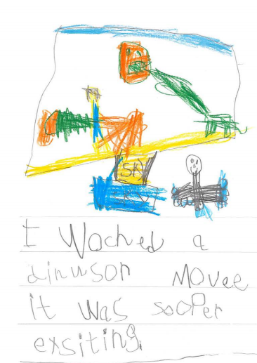
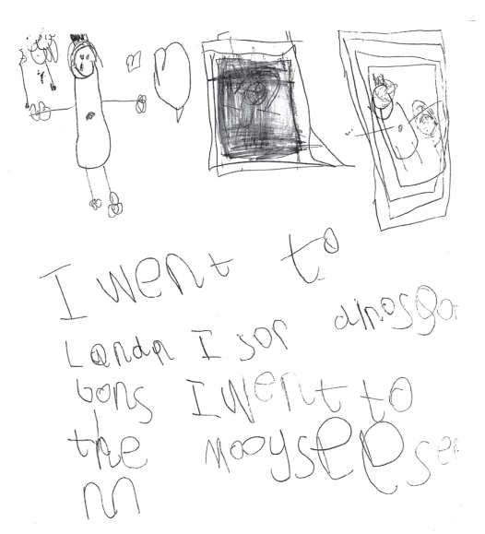

Slide 17
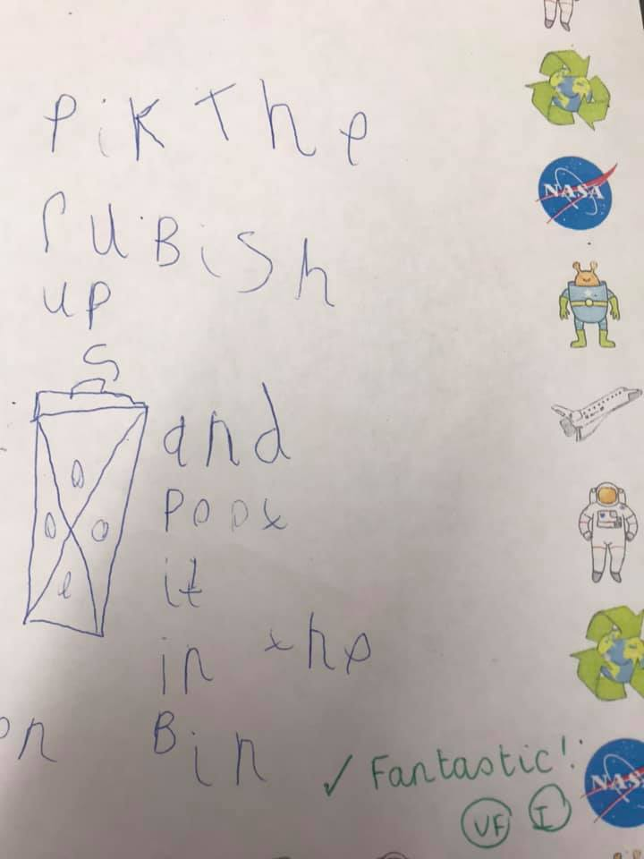
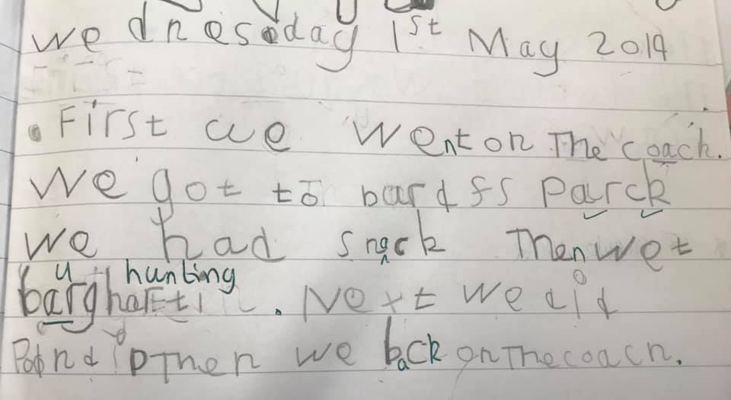

Slide 18
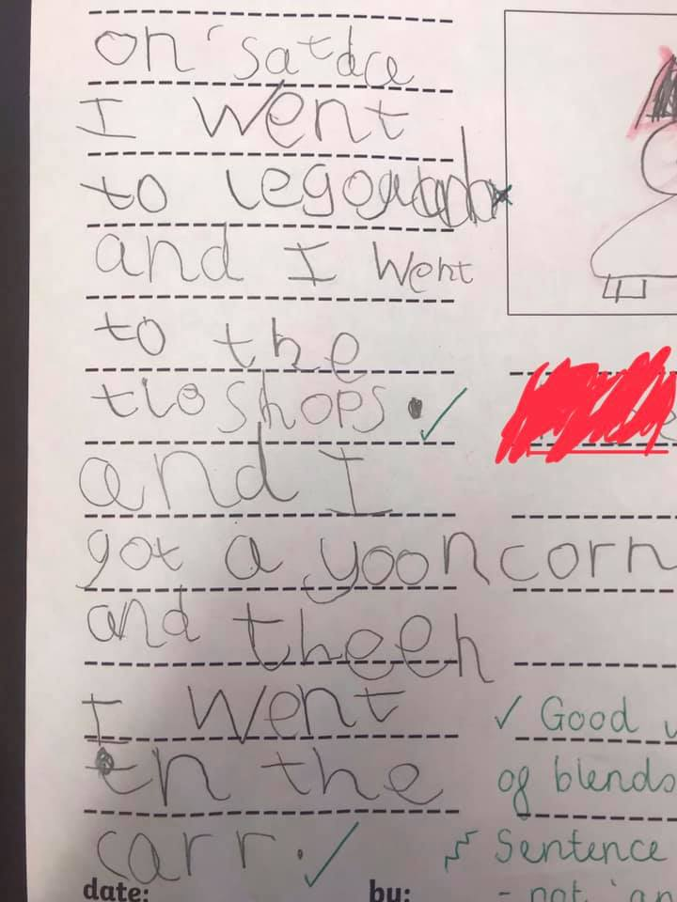

Slide 19
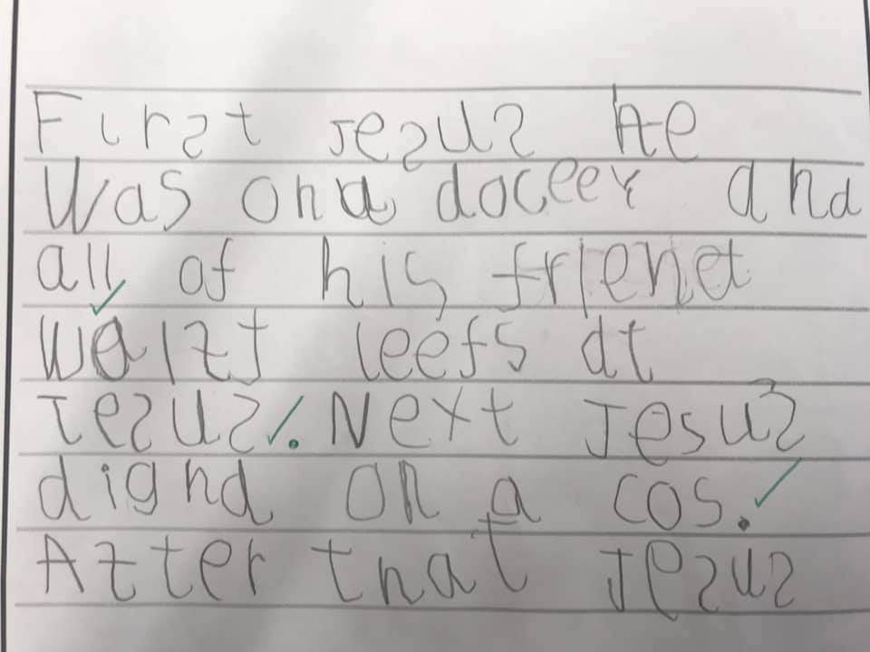

Slide 20
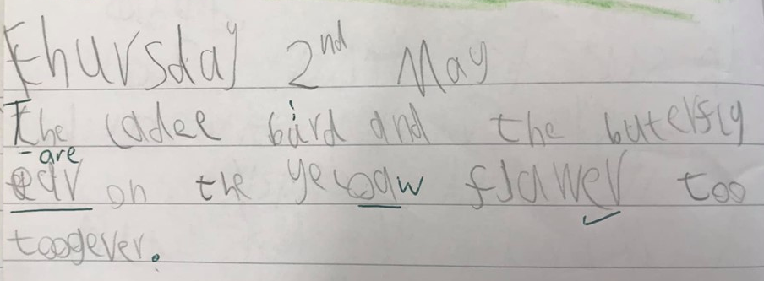

Slide 21
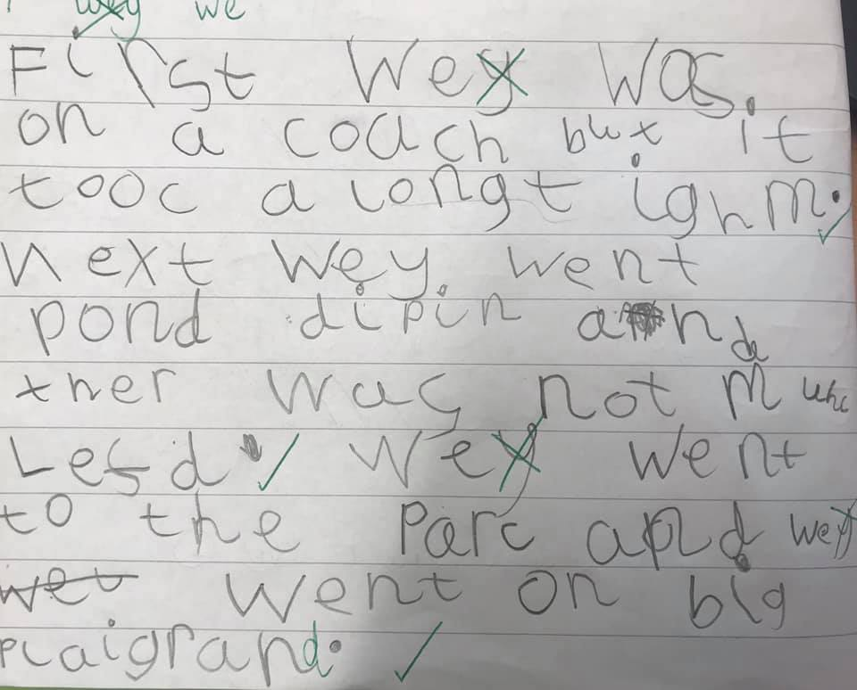

Slide 22
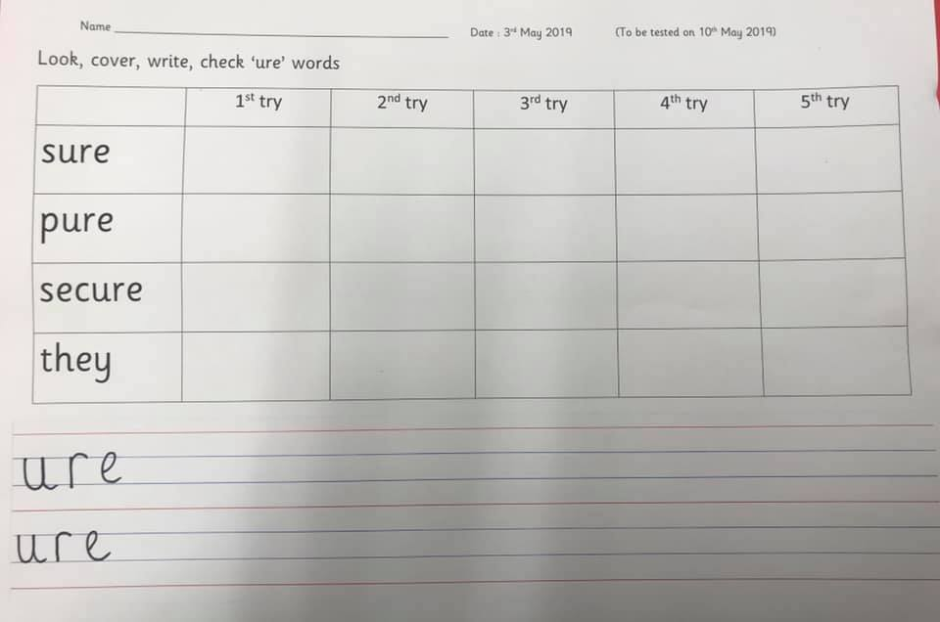
Spellings
Good practice for Year 1.
Please don’t worry about the scores – spellings are practice for Year 1 and they’re not something we want the children to become overly concerned about.
Short practise sessions throughout the week
Look – cover – write – check
Extend: can they write a sentence with that word in?
Please return the spelling book each Friday in your child’s book bag

Slide 23
Useful apps and websites
www.crickweb.co.uk
YouTube – Mr Thorne does Phonics
www.letters-and-sounds.com
Twinkl phonics app
Hairy Letters app
Mr Thorne does Phonics app
Bee-Bot app (great for ICT and maths language)
Forest Phonics app
www.topmarks.co.uk
www.phonicsplay.co.uk
Teach your Monster to Read
Sounds write app
Numberblocks app
Bug Club!

