Slide 1
Year 1 phonics screening

Slide 2
What is Phonics?
*The children have a 25 minute daily phonics lesson. *Children are taught to read by breaking down words ‘graphemes’ into separate sounds or ‘phonemes’. They are then taught how to blend these sounds together to hear and read the whole word.
There are around 40 different sounds.

Slide 3
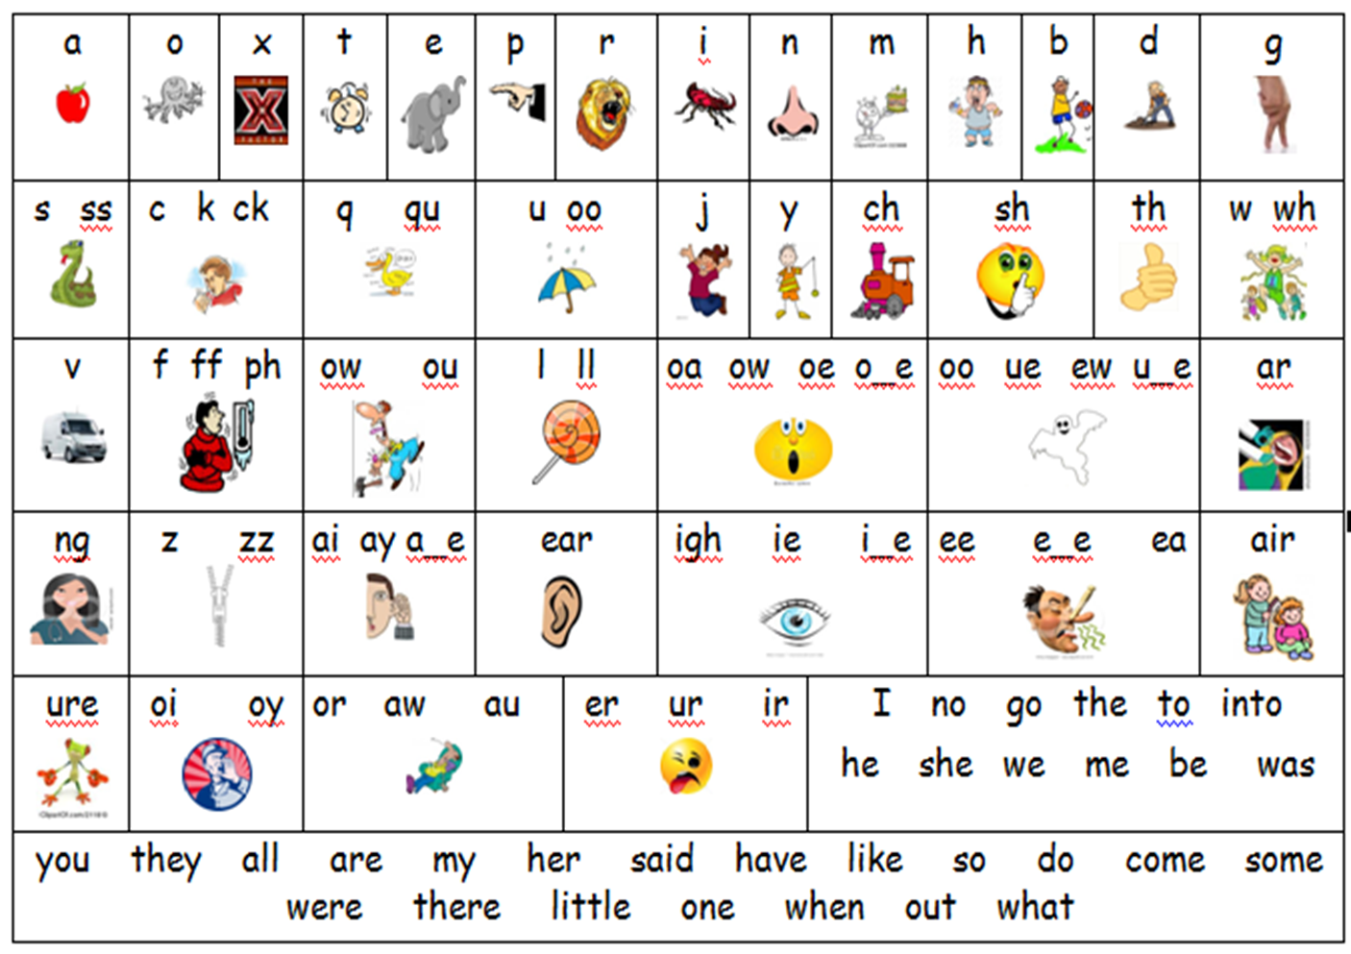

Slide 4
Why year 1?
*Every Year 1 child in the country will be taking the statutory phonics screening check in June.
*The check is very similar to tasks the children already complete during phonics lessons and it will be done with Miss Spears.
*The focus of the check is to ensure that all children can read by the end of year 2. The year 1 screening (mid point) will provide evidence to help teachers plan for year 2.
It is not a reading test!

Slide 5
What will the children do?
*The check will take 4 to 9 minutes to complete;
*They will be asked to ‘sound out’ a word and blend the sounds together. e.g. d-o-g – dog
*The check will consist of 40 words and non-words;
*Children will be told if the word is a real or ‘alien’ word, with a corresponding alien image.

Slide 6
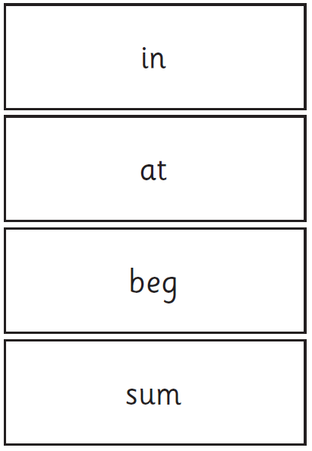
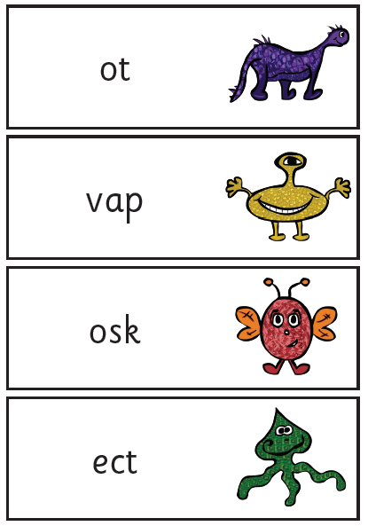
Examples of words

Slide 7
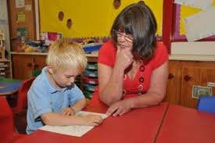
How will it be administered?
*Miss Spears will conduct all of the screening checks with the children. The children will be familiar with this routine.
*The children will complete the check one to one in a quiet area of the school.
*We are not permitted to indicate to the children at the time whether they have correctly sounded out and / or blended the word.

Slide 8
And the results...?
*The children will be scored against a national standard (determined by DfE)
*We will inform you of the results during the summer term.
*If your child’s score falls below the national standard they will be supported and will complete the screening in year 2.

Slide 9
How can you help?
Encourage your child to use their knowledge of sounds to work out the words when reading and writing.
Digraph- 2 letters making one sound cow the children should say this as c-ow and not c-o-w
Trigraphs- 3 letters making one sound night the children should say this as n-igh-t and not n-i-g-h-t which does not sound like night.
Split digraphs- 2 vowels with a consonant in between. Use to be known as the magic e! spine - i_e home – o_e cube – u_e

Slide 10
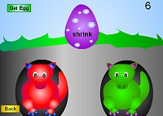
How can you help? Children can practise their phonics by playing games online. They should work on phase 5 games
Mr Thorne does phonics https://www.youtube.com/channel/UC7sW4j8p7k9D_qRRMUsGqyw www.phonicsplay.co.uk

Slide 11
How can you help?
REMEMBER: Phonics is not the only way you become a good reader. Continue to read with your child each night and encourage them to:
*Sound out the words and blend the sounds together.
*re-read to check it makes sense, and use pictures for clues.
* Ask questions about the book.
* And most importantly ENJOY READING!

Slide 12
Terminology
Phoneme – a single unit of sound e.g. ‘p’ ‘sh’
Grapheme – the written phoneme
PGC – phoneme / grapheme correspondence – being able to match up the sound and the letter shapes
Blending – merging sounds into words
Segmenting – breaking words into sounds
CVC – consonant/vowel/consonant e.g. ‘cat’ ‘chain’
TW - Tricky Word – a word that is not phonetically spelled e.g. ‘the’.
HFW – High frequency word – those that are most common
Digraph / Trigraph – a sound made up of 2 or 3 letters
Split Digraph – What we used to call magic/silent ‘e’ words. E.g. ‘make’.

