Slide 1
Beech, Walnut & Maple
Year 5 & 6
2019-20
Miss Roberts, Mr Jones, Miss Burton, Mrs Meredith
Miss O’Reilly

Slide 2
Attendance and Punctuality
All children should arrive in school between 8.45 and 8.55 am and we ask that you drop and go. Children should come straight into the school building via the playground
They should be prepared for the day, having eaten breakfast
If your child is un-well please notify the office as soon as possible – please keep children off school for 48 hours after an upset stomach
In line with government policy, holidays may no longer be taken during term time.
Lateness is monitored; your child should sign in at the office if they arrive after 8.55am
Certificates and prizes are awarded for classes and individuals with excellent attendance
Please encourage your children to attend even if feeling a little under the weather.

Slide 3
End Of School Day
As our school continues to expand we become more aware of the need to dismiss our children in a safe and orderly manner. School staff will lead their classes to the school playground where they should wait until they identify their parent/carer.
Dogs are not permitted on the school premises and should not be left unattended.
If collection arrangements are not the norm, please inform the office – dojo’s will not be picked up during school hours.
Car parks are dangerous and should not be accessed by parents or children at any time. Staff have been asked to challenge parents on this to keep children safe.

Slide 4
War & Conflict
Key areas of study:
Who, What, When, Where and Why?
Important People
Timeline of WWII
Mapping the Axis and Allied movements
Discoveries and breakthroughs made during the war
Influence of WWII on the modern world.

Slide 5
Educational Visits & Visitors
Bletchley Park
Meeting a survivor from the Holocaust
Working with the national program to celebrate the Kindertransport

Slide 6
Other Curriculum Areas
Science
Electricity
Forces
Evolution & Inheritance
Living things & their habitats
Animals including humans
Art
Silhouette painting in watercolour
Propaganda posters
ICT
E-safety
Computing – coding and animation
Music
Dancing In The Street
Design Technology
Trench Models
RE & PSHE
Judaism & Christianity
PE
Speed, Agility & Quickness plus indoor athletics, Dance (WWII themed) & Friday fun run

Slide 7
Parent Helpers
The school website has a link where you can sign up to become a reading volunteer.
This is an especially important role within the school and one that becomes harder to cover, but no less important, as children become older. If you can offer any time it would be much appreciated.

Slide 8
English
Historic fiction
Journalistic writing
Biographies
Poetry
Script writing
Persuasive Letters
Narrative writing
Balanced arguments
Class books
Spelling, Punctuation & Grammar
Supported through guided reading activities and homework activities and taught
explicitly in class.

Slide 9
Maths
Times tables – children should practise their tables targets at home. Children are working towards certificates as part or our Times Tables Olympics which involves a 3 minute speed test.
Finalist – 2s, 5s, 10s
Bronze – 2s, 3s, 4s, 5s, 10s
Silver – 6s, 11s
Gold – 7s, 8s, 9s, 12s
European Champion – All (60 mixed questions)
Olympic Champion – All (100 mixed questions)
Calculations policy – this is available on the school website.
Maths workshops will be held termly, schedule of upcoming
topics will be posted on the school website.

Slide 10
Homework
Each weekend your child will be set a piece of Topic/English and Maths homework. This will often be linked to their work in class. Please support your child in completing this. They have been provided with a purple homework book into which their work should be completed.
Homework will be monitored and marked by adults in school and shared in the classroom, with children being given the opportunity to peer review.
Reading – encourage children to read at home as often as possible. If you no longer need to hear your child read (because they are a confident free reader), then please discuss their reading with them. Comments and reviews can be added to reading journals.
Spellings – weekly spellings to learn at home. Please use a range of the given strategies to encourage your child
Times Tables – as previously discussed
Your child may also occasionally bring work home to finish.
Homework will now be posted weekly on the school website should you require
an additional copy. It will be distributed on Fridays to be collected in the following
Tuesday.

Slide 11
Year 6 School Journey
18th-22nd May 2020 (the week after SATs)
We are in the process of planning our school journey this year, details to follow in due course. It will follow a similar format to previous years, with a mixture of traditional sea-side fun, days out and adventurous activities.
Deposits will be due before Christmas, with the balance paid before the Easter break.
Please talk to your class teacher if you have any questions or concerns.

Slide 12
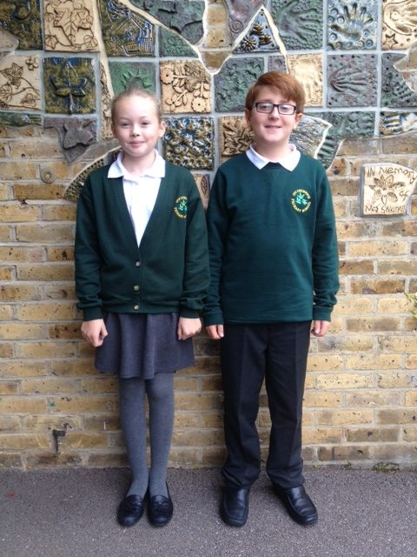
School Uniform
All children are expected to wear the
appropriate school uniform at all times.
Grey skirt, pinafore, shorts or trousers.
White polo top.
School jumper or cardigan.
Plain black shoes – not trainers, no heels, no boots
No make-up or nail varnish should be worn in school
No jewellery should be worn, except plain
stud earrings and watches.
Hair accessories should be minimal and functional only.
PLEASE ENSURE EVERYTHING YOUR CHILD WEARS IS
CLEARLY LABELLED.
Bag sizes: please keep these A4 size or less

Slide 13
PE Kit
Your child should have the appropriate kit in school every day, in a named drawstring bag.
Trainers
A change of socks
White school t-shirt
Green shorts
Children may also bring tracksuits to wear for outdoor activities in PE
Children should remove all earrings for PE and must do this themselves. Please ensure piercing is organised for the start of the summer holidays so they have time to heal.
Essex guidelines now state that no earrings can be worn during PE.

Slide 14
Daily Mile
As a school have implemented a daily mile activity and now have use of a purpose-built running track, funded by the FOICs.
It has been well publicised that there is a positive impact on physical health, mental wellbeing, concentration and sleep patterns when daily bursts of sustained physical activity are undertaken.
They won’t be changing into full PE kit for this but will need to change into trainers. These should be available everyday in school.

Slide 15
Water and Snacks
Children should bring in a named water bottle to keep in the classroom for drinks during lesson time. This should be in school all year, not just during summer months. We would prefer that this is not a single use plastic bottle, as we are striving to be an eco friendly school and each plastic bottle takes 300 years to break down.
Only healthy snacks, namely fruit & vegetables, may be brought in to be eaten at break times – products containing nuts are not allowed.
As a healthy school we do not allow the distribution of
sweets as a part of birthday celebrations.

Slide 16
E-Safety
In school, our internet is restricted to ensure safety and suitable content. We educate and encourage children to stay safe whilst using social media. We remind them that Whatsapp, Twitter, Instagram etc all have age restrictions (13yrs or 16yrs) and that these should be followed both in school and at home. Children will be signing a class charter to say that they understand these recommendations and guidelines and will abide by them.
Parents can stay in touch with news, announcements, assemblies and achievements via the school website, blog, Twitter and Class Dojo accounts.
Please discuss sensitive issues face-to-face and be aware that electronic communication is unlikely to be responded to outside of school hours.

Slide 17
SATs
Year 6 children will be taking their National Curriculum Tests between May 11-14th 2020.
SATs sample papers are available for you to look at.
CGP SATs revision books are also available to view, with the opportunity to purchase these at reduced rates. Order forms will be sent home in due course.

Slide 18
Maths Teaching
Last year we trialled flexible groupings in Maths. We are intending on using this structure again in this academic year. This means your child, may be taught some of their lessons each week in another Year 5/6 class with another teacher.
These groups are designed to support the needs of your child. They will be meeting the same objectives in each class but the groups will have varied degrees of support and extension. Groups are flexible and children may move between them over the course of the term.

